Slide 1




Extra Session (Discussion)
10th Oct, 2025
Computer Vision
Prof. Jayanta Mukhopadhyay
Professor
Computer Science and Engineering Department
IIT Kharagpur
Ayan Paul
PMRF Research Scholar
IIT Kharagpur

Slide 2
Topics on which Week 1 Assignment Questions are based
Image
Geometric Definition of Image
Image Processing Concepts and Operations
Image Transforms

Slide 3
Topics on which Week 2 Assignment Questions are based
Real Space and Projective Space
Points and lines in Projective Space
Intersection of Parallel Lines and Lines at Infinity
Conics in Homogeneous Space
Projective transformation
Transformation of points, lines and conics under Homography
Measurement of angle under Homography

Slide 4
Topics on which Week 3 Assignment Questions are based
Camera Geometry
Pinhole Camera Mapping, Offsetting Principal Point, Shifting World Coordinate
CCD Camera Model
Projective Camera Matrix and its Properties
Camera Parameters from Projective Camera Matrix
Projective Camera on Plane and Line
Camera at Infinity, Affine Projections, Vanishing Points and Vanishing Line

Slide 5
Topics on which Week 4 Assignment Questions are based
Stereo geometry
Epipolar geometry
Fundamental and Essential Matrix
Properties of Fundamental and Essential Matrix
Computing Depth
Estimation of Fundamental Matrix

Slide 6
Topics on which Week 5 Assignment Questions are based
Singularity constraint of F and E
Parametric representation of F
Retrieving camera matrices from F
Computing scene points
Line reconstruction
Plane-induced Homography
Affine stereo
Stereo geometry Summary

Slide 7
Topics on which Week 6 Assignment Questions are based
Feature Detection
Harris Operator
Feature Descriptor and Feature Matching
Harris-Laplacian and SIFT
FAST, BRIEF, ORB
Region Descriptor – Patch Descriptor, Texture Descriptor and Global Image Descriptor

Slide 8
Topics on which Week 7 Assignment Questions are based
Key point matching – distance and similarity functions
Matching criteria – distance-based and matching histograms
Efficient computation of feature matching – range query, indexing (K-D tree) and hashing (LSH)
Straight line Model fitting – Least squares, Total least squares, RANSAC, Hough voting

Slide 9
Topics on which Week 8 Assignment Questions are based
Color Definition and Color Perception
Trichromacy, Linear Color Spaces and Color Matching
Color Models – RGB, CMY, CIE XYZ, CIE Chromaticity, CIE La*b*, YIQ, YCbCr, HSV
Color Constancy
Color Transfer
Color Demosaicing and Interpolarions – Bilinear, Averaging Red Blue Hues, and Laplacian Corrected Edge Correlated (LCEC)

Slide 10
Topics on which Week 9 Assignment Questions are based
Different types of range sensors - Stereo imaging, Time of flight, Triangulation through scanning beams, Structured light
Differential geometry in extracting local features of a pixel (point) in a range image - Surface normal, Principal Curvatures, Gaussian curvature, mean curvature.
Characterization of step and roof edges.
Segmenting range images into planar patches.
Registration of range images.

Slide 11
Topics on which Week 10 Assignment Questions are based
Types of Learning
Clustering – K-Means, K-Medoids, Gaussian Mixture Model
Classification – Bayesian Classifier, K-Nearest Neighbor Classifier, Linear discriminant analysis (LDA) from Bayes’ classifier, Perceptron classifier, Artificial neural network (Multi-layered feedforward classifier and Regressor).
Evaluation of a classifier
Cross Validation

Slide 12
Topics on which Week 11 Assignment Questions are based
Dimension reduction techniques - Principal Component Analysis and Fisher’s Linear Discriminant Analysis
Sparse representation
Pursuit algorithm - Matching pursuit, Orthogonal matching pursuit, and Basis pursuit
Dictionary learning and sparse representation – K-SVD

Slide 13
Topics on which Week 12 Assignment Questions are based
Convolution Neural Network (CNN)
CNN Architectures – LeNet, AlexNet, ZFNet, VGG, GoogleNet, and ResNet
CNN for Detection – RCNN, Fast RCNN, and Faster RCNN
CNN for Semantic Segmentation – Unet
Recurrent Neural Network (RNN)

Slide 14
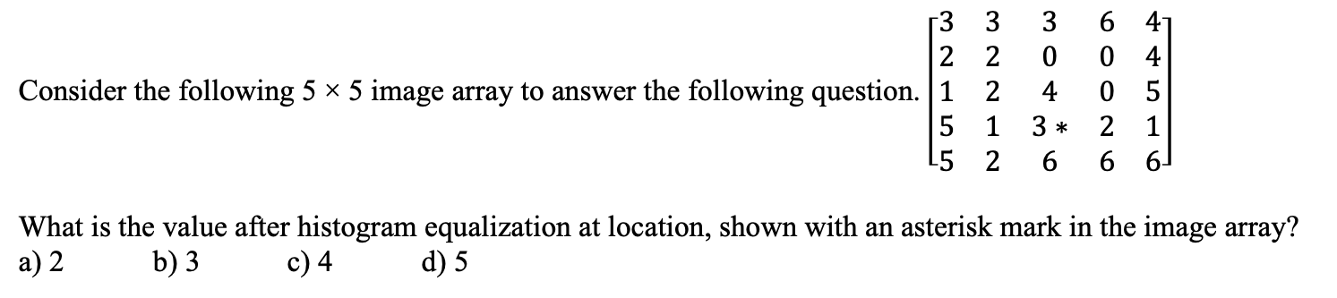
QUESTION 1
SOLUTION 1
Pixel | Frequency | Cumulative Sum | Normalized Sum | New Pixel
0 | 3 | 3 | 0.72 | 1
1 | 3 | 6 | 1.44 | 1
2 | 5 | 11 | 2.64 | 3
3 | 4 | 15 | 3.60 | 4
4 | 3 | 18 | 4.32 | 4
5 | 3 | 21 | 5.04 | 5
6 | 4 | 25 | 6.00 | 6
Computation of Histogram equalization is shown in the following table.
According to the above table pixel value 3 becomes 4. Hence, 4 is the answer.
CORRECT ANSWER 1
c)

Slide 15
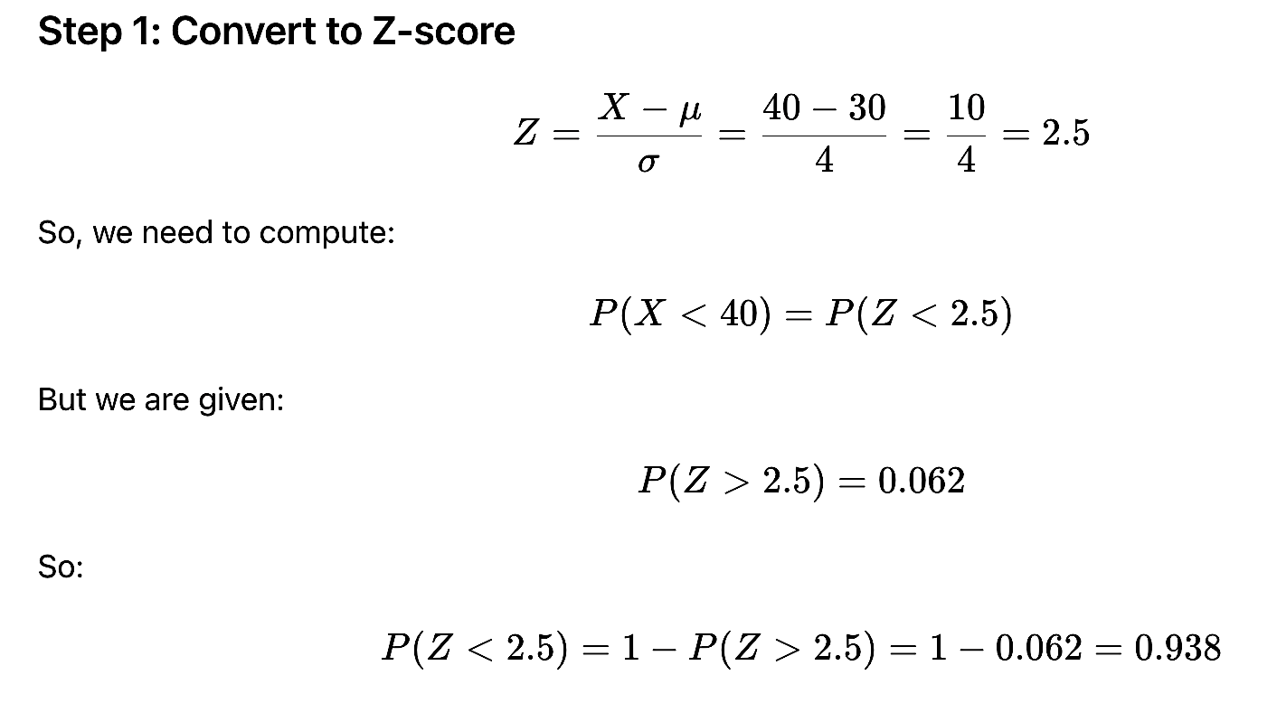
QUESTION 2
Note: Note that the probability of a normal variable P(z > 2.5) = 0.062. X is a normally distributed variable with mean μ = 30 and standard deviation σ = 4. Compute P(X < 40).
a) 0.0238
b) 0.9380
c) 0.1538
d) 0.0918
SOLUTION 2
CORRECT ANSWER 2
b)

Slide 16
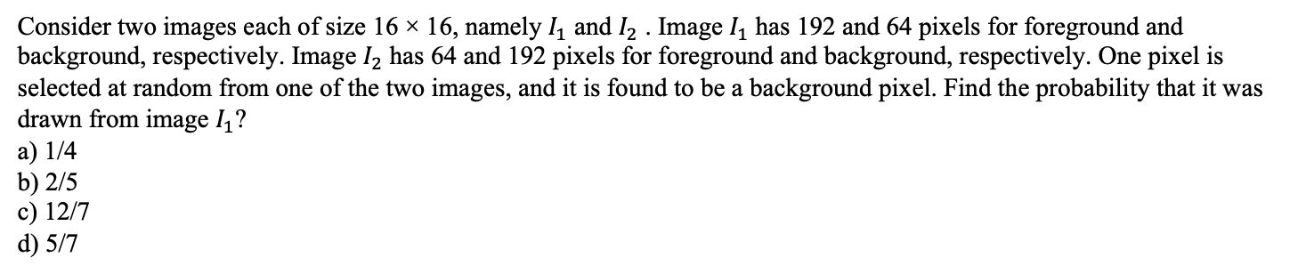
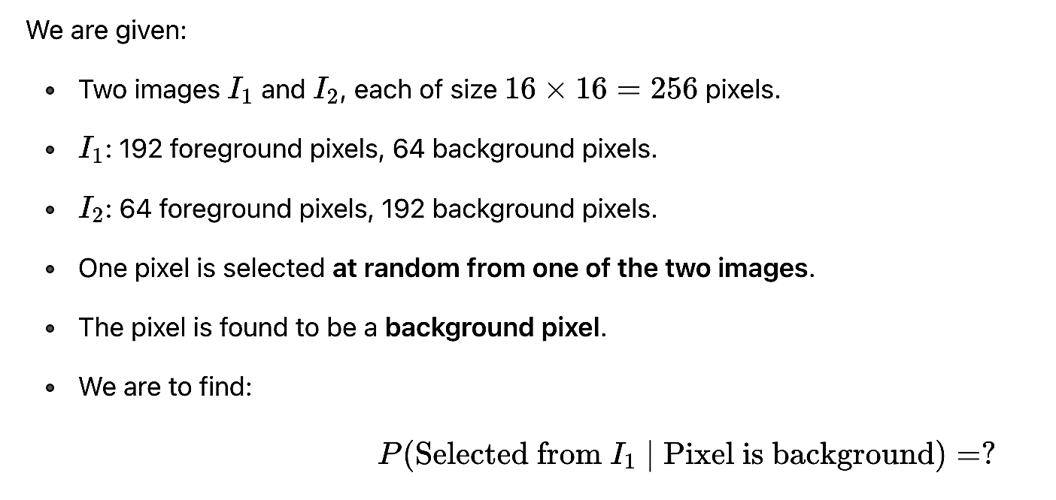
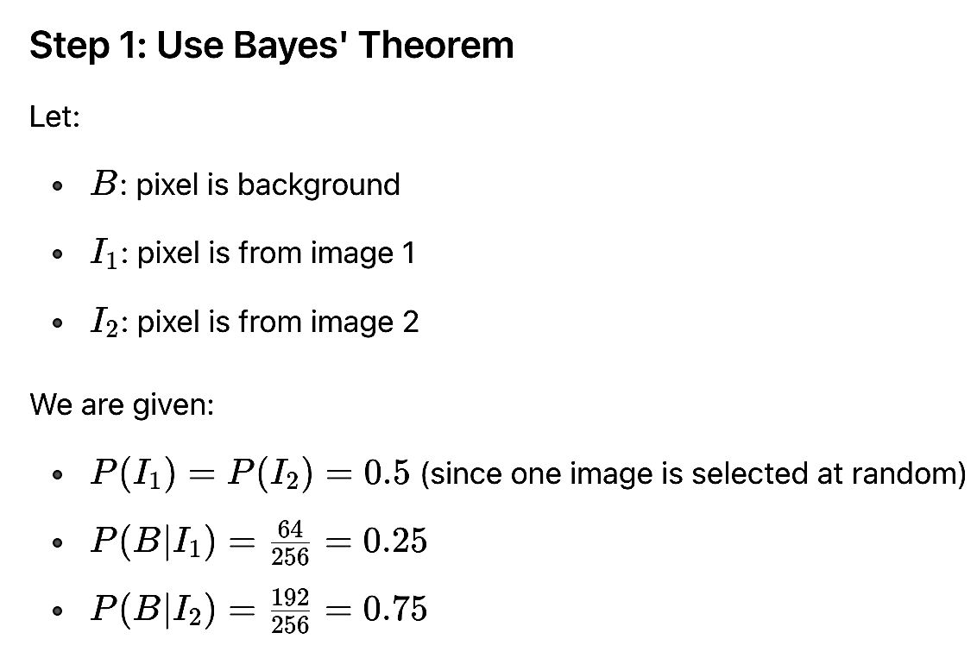
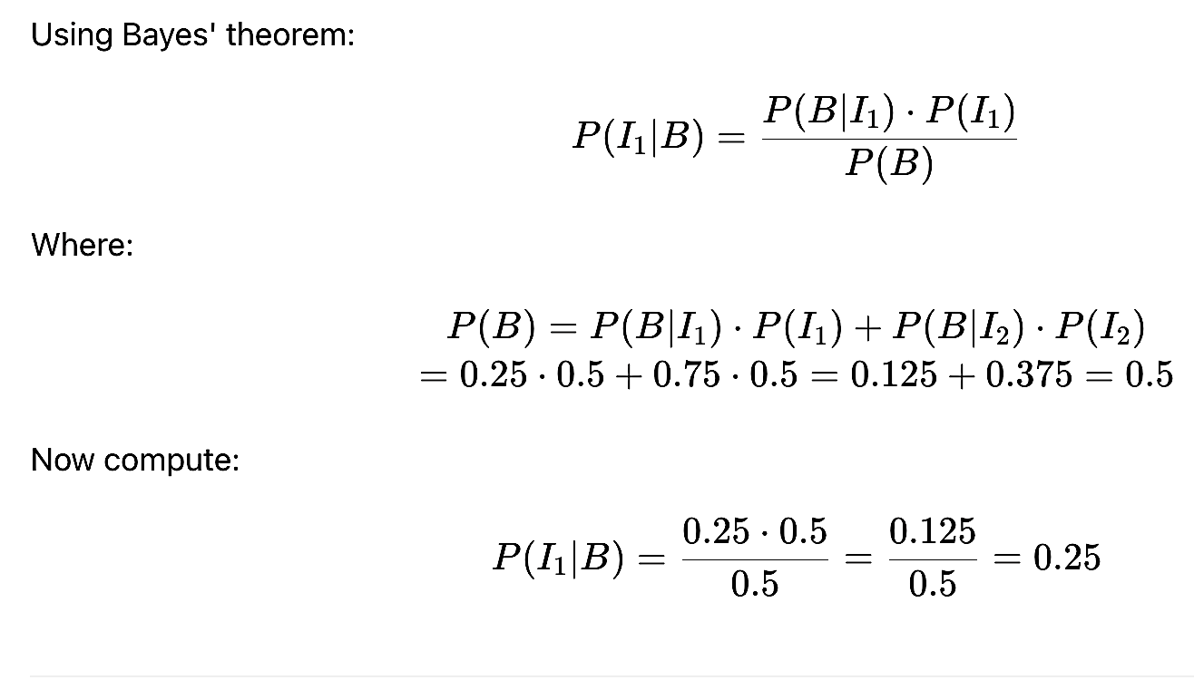
QUESTION 3
SOLUTION 3
CORRECT ANSWER 3
a)

Slide 17
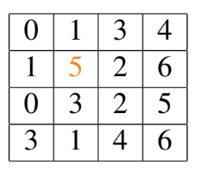
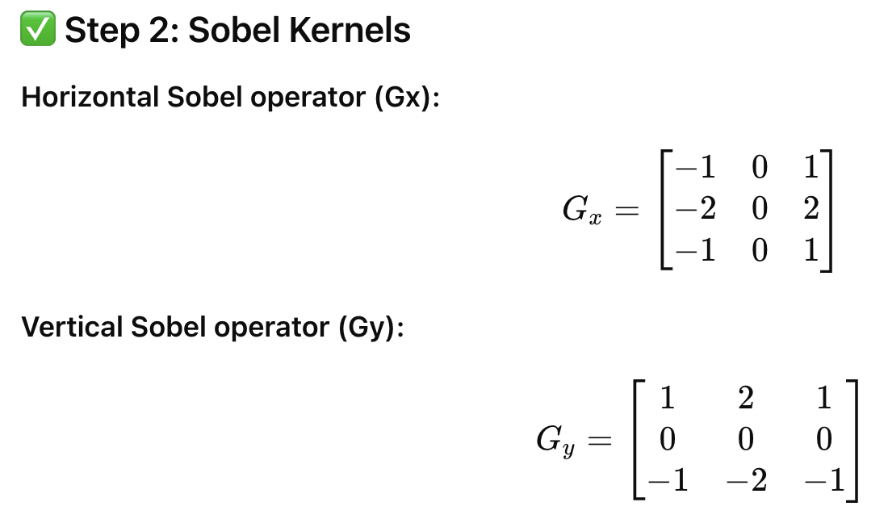

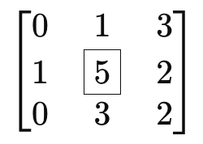
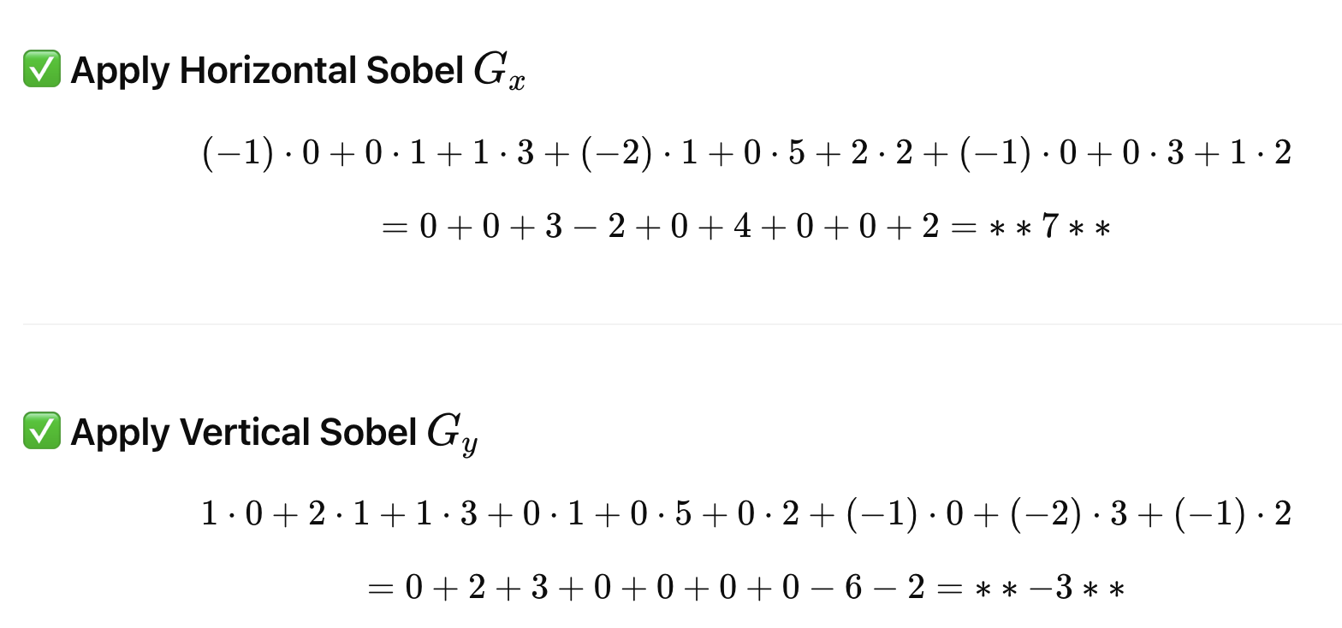
QUESTION 4
Consider the following 3-bit grey scale image
What is the value when vertical Sobel operator and horizontal Sobel operator are applied on the orange colored pixel?
a) 0 and 2
b) 7 and -3
c) 10 and 2
d) 2 and 10
SOLUTION 4
CORRECT ANSWER 4
b)

Slide 18
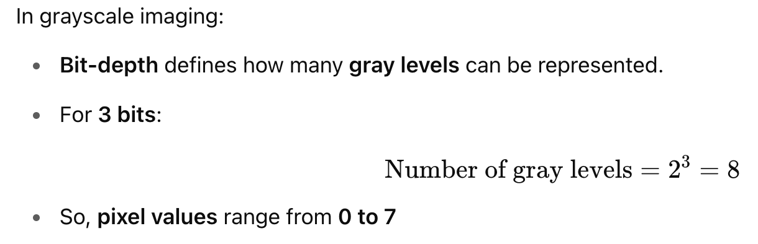
QUESTION 5
Consider a 3-bit grey scale image with dimension 32 × 32. What will be the range of values in its X-axis?
a) 0 to 7
b) 1 to 7
c) 0 to 15
d) 0 to 255
SOLUTION 5
CORRECT ANSWER 5
a)

Slide 19
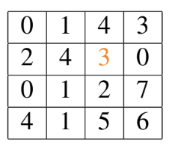
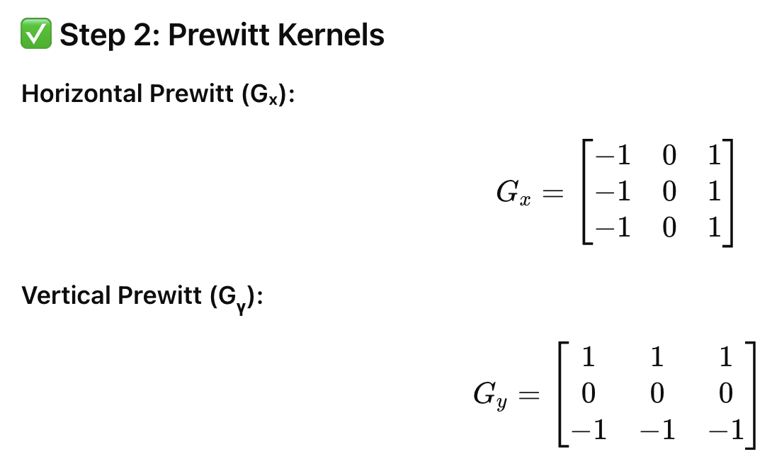
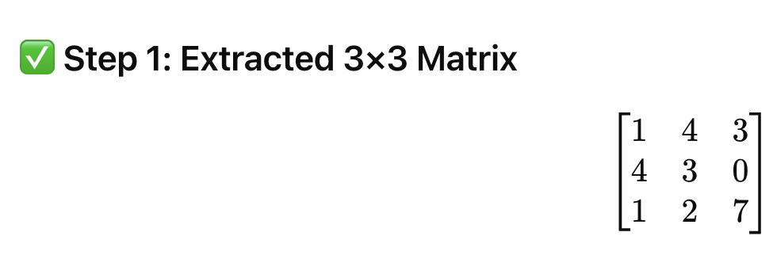
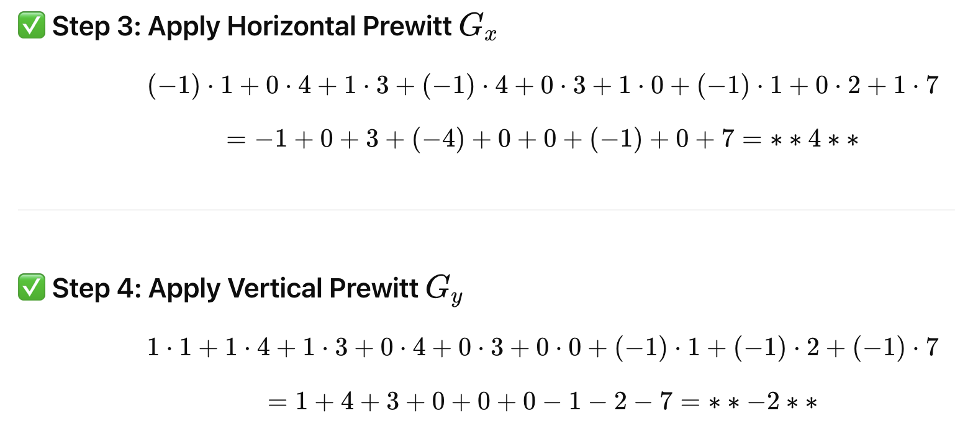
QUESTION 6
Consider the following 3-bit grey scale image
What is the value when horizontal Prewitt operator and vertical Prewitt operator are applied on the orange colored pixel?
a) 0 and 2
b) −4 and −2
c) 4 and −2
d) −4 and 2
SOLUTION 6
CORRECT ANSWER 6
c)

Slide 20
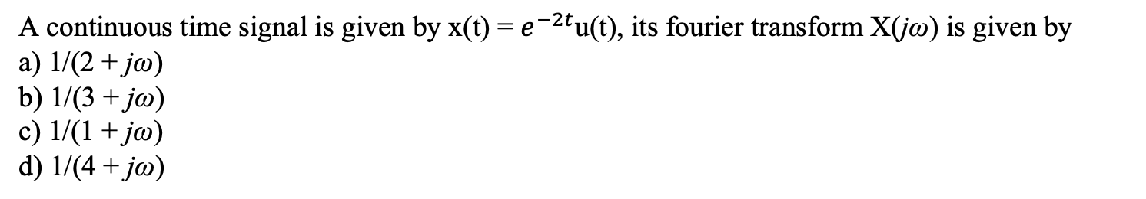
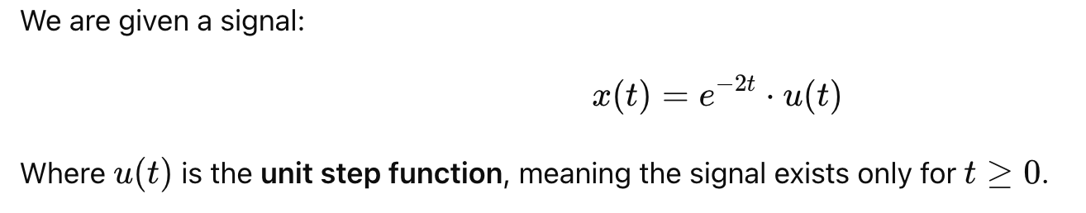
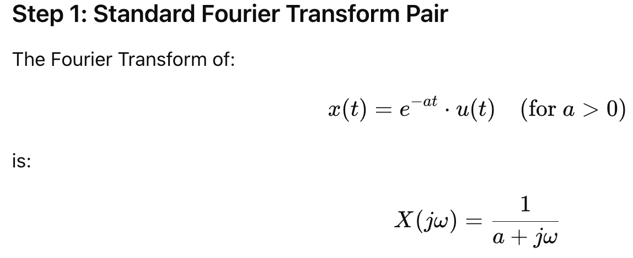
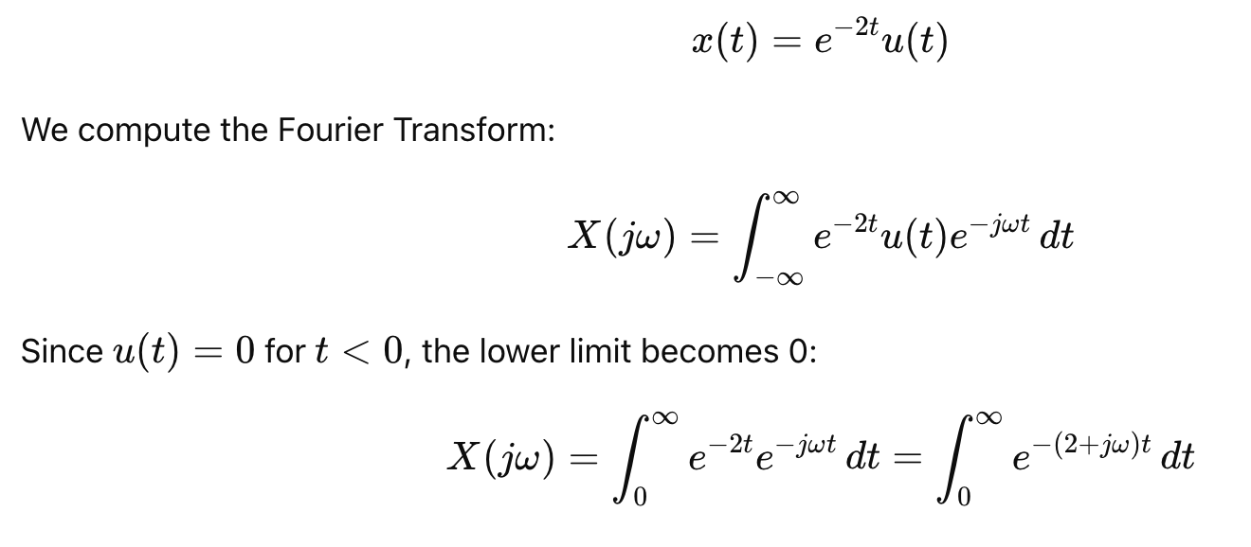
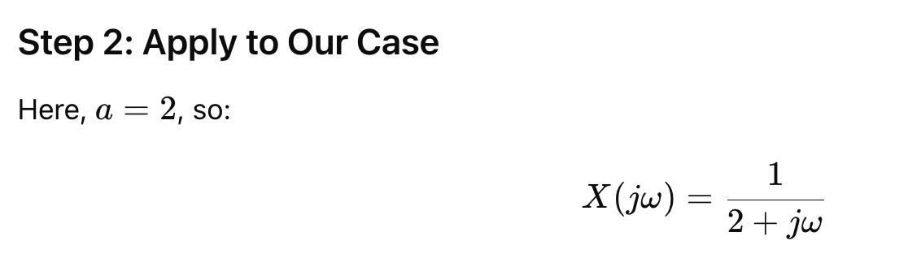
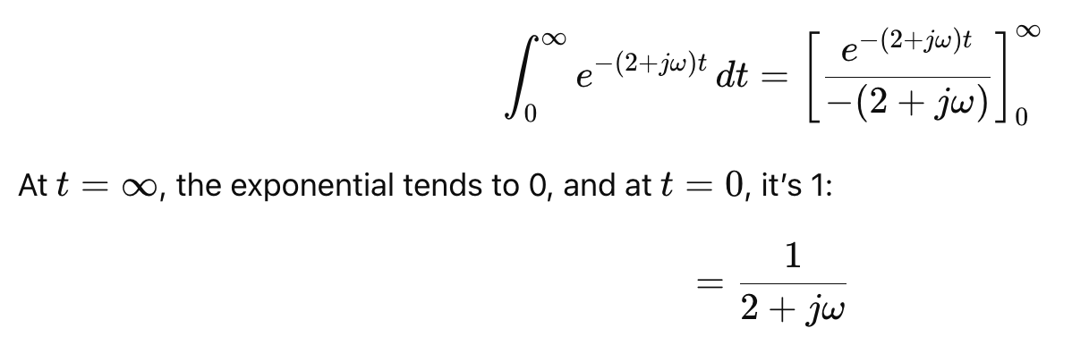
QUESTION 7
SOLUTION 7
Alternatively
CORRECT ANSWER 5
a)

Slide 21
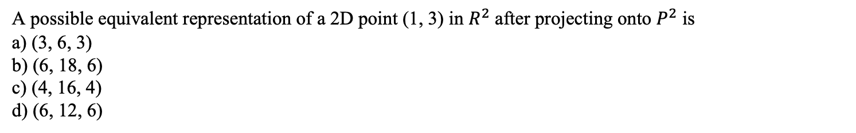
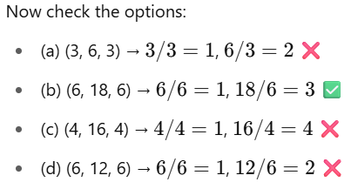
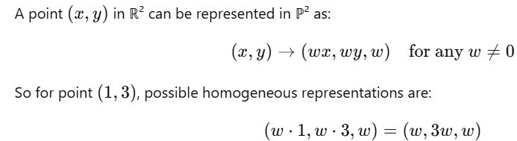
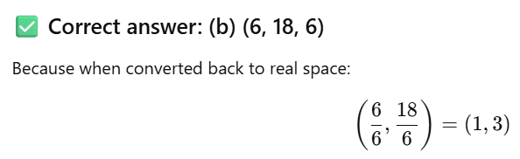
QUESTION 8
SOLUTION 8
CORRECT ANSWER 8
b)

Slide 22
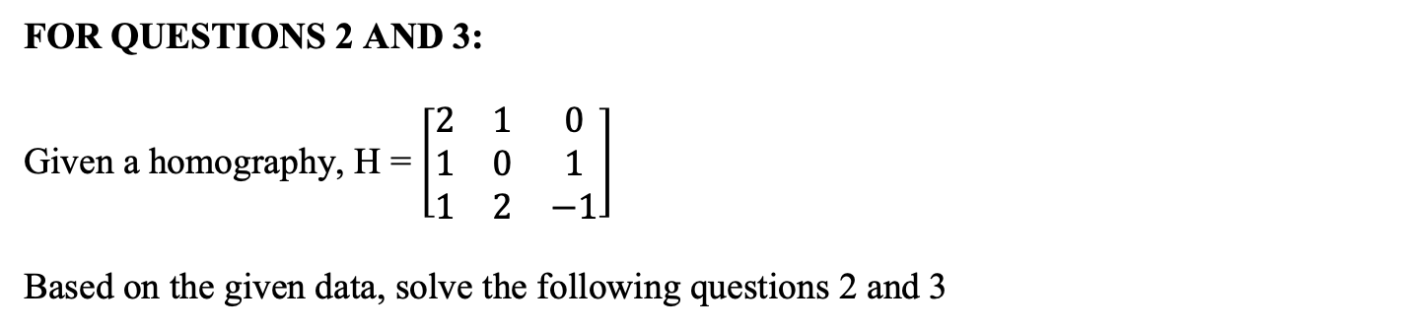
9 and 10
9 and 10

Slide 23
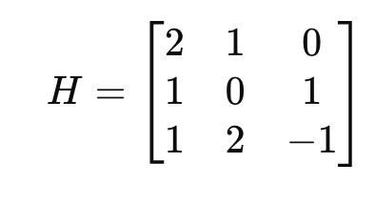
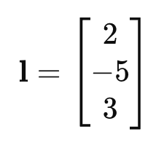
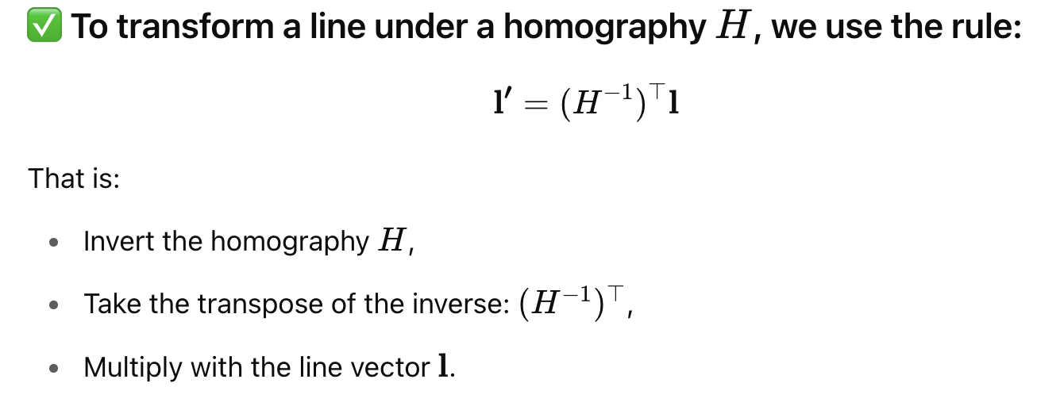
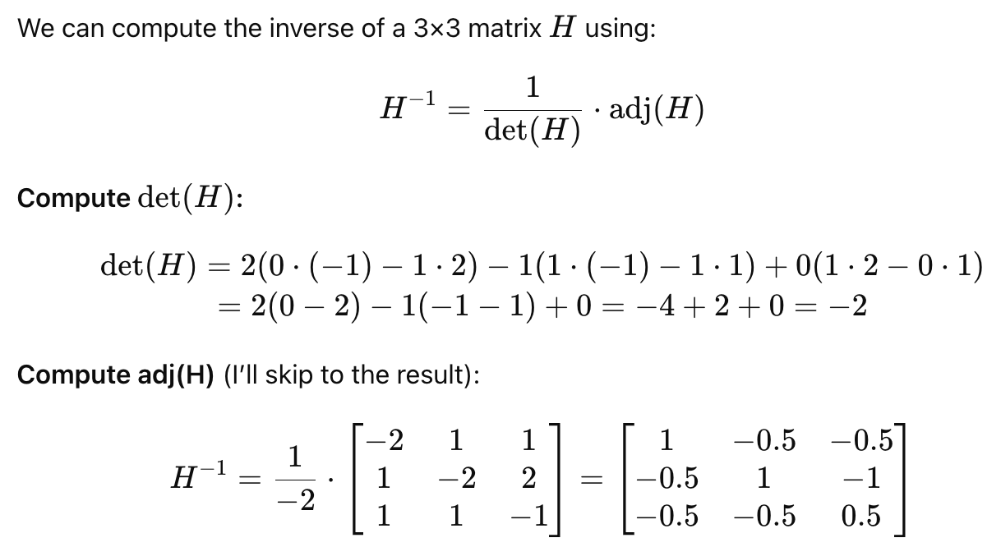
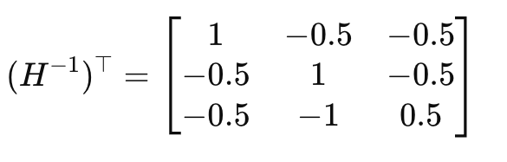
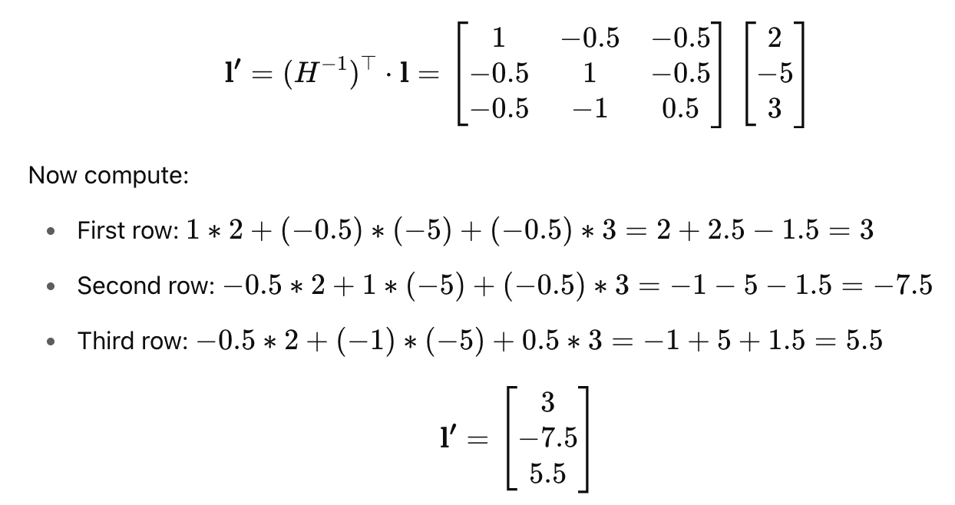
QUESTION 9
Find the transformation of the line 2x − 5y + 3 = 0.
a) 2x − y − 4 = 0
b) 6x − 15y + 11 = 0
c) 4x + y − 5 = 0
d) 2x − 0.5y + 4.5 = 0
SOLUTION 9
CORRECT ANSWER 9
b)

Slide 24
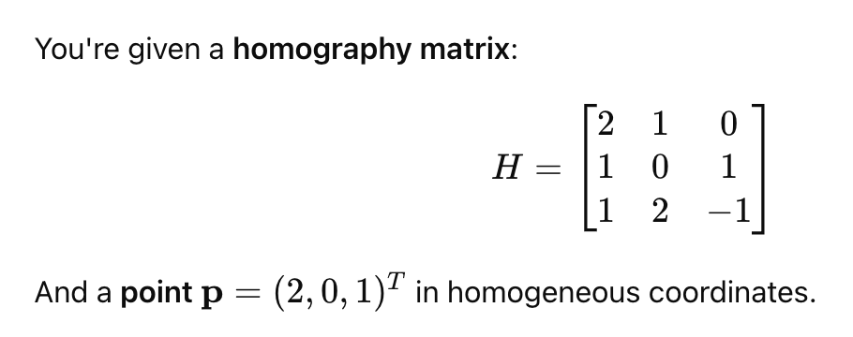
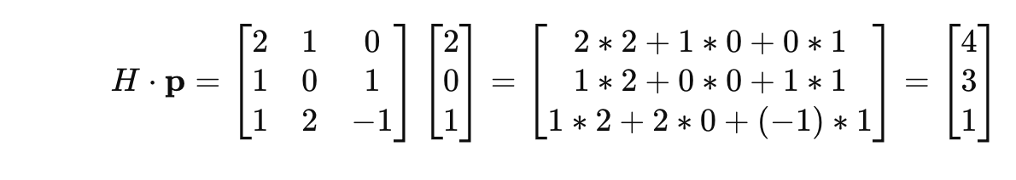
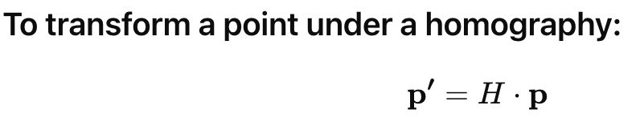
QUESTION 10
Find the transformation of the point p(2, 0, 1).
a) p(4, 3, 1)
b) p(2, 1.5, 1)
c) p(2, 3, 1)
d) p(3, 4, 1)
SOLUTION 10
CORRECT ANSWER 10
a)

Slide 25
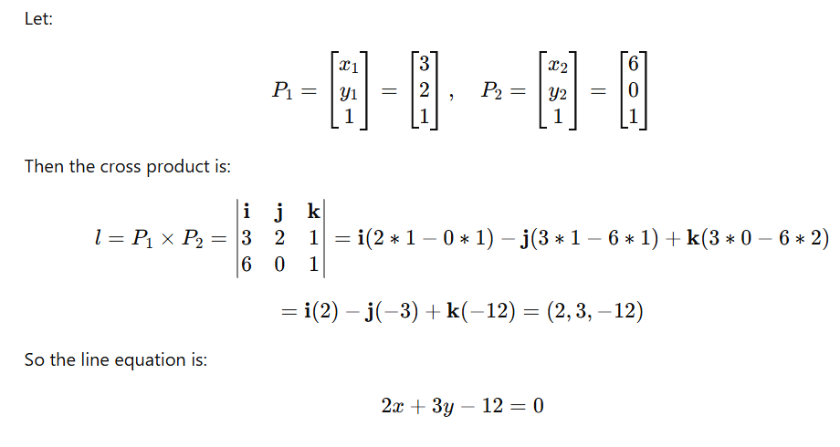
QUESTION 11
Compute the line passing through the points (3, 2) and (6, 0).
a) −3x + 2y + 1 = 0
b) −2x + 5y + 12 = 0
c) −5x − 2y + 1 = 0
d) 2x + 3y − 12 = 0
SOLUTION 11
CORRECT ANSWER 11
d)

Slide 26
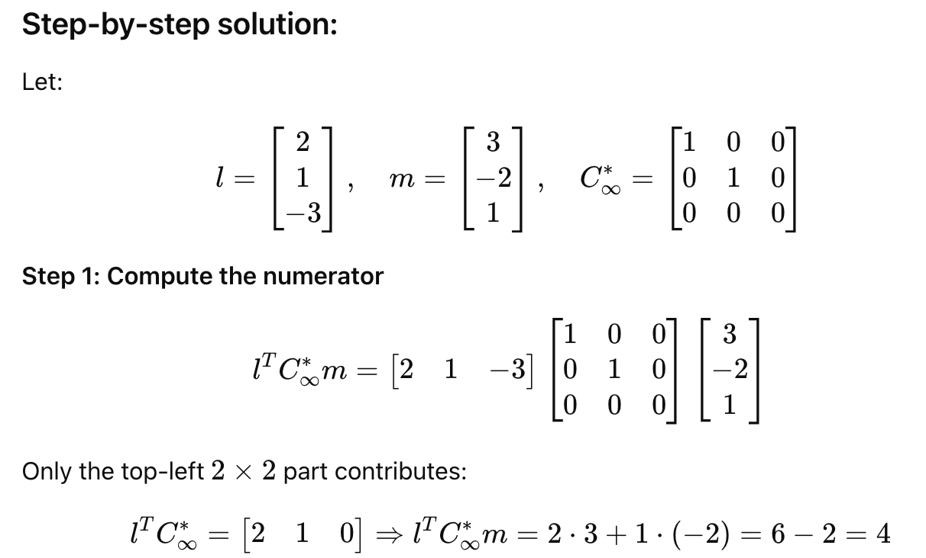
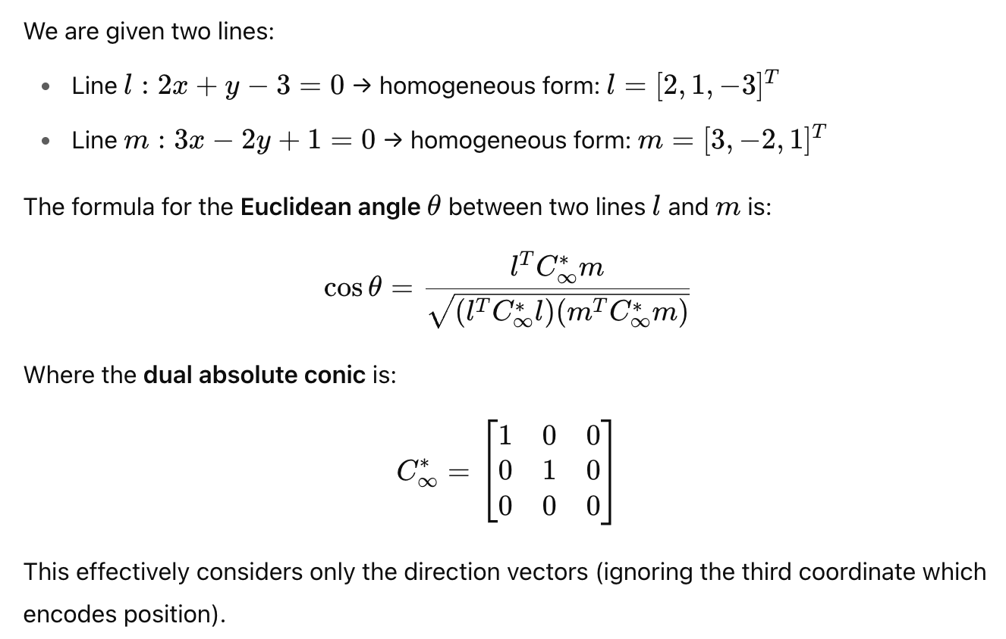
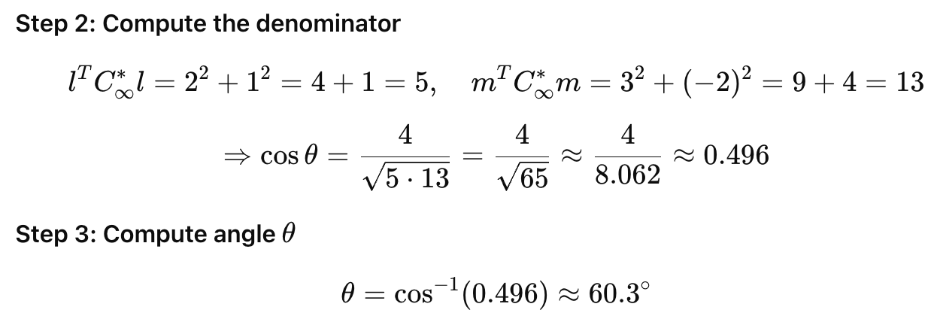
QUESTION 12
Given two lines l = 2x + y − 3 = 0 and m = 3x − 2y + 1 = 0 meet at a point p. Find the Euclidean angle between these two lines. Answer should be in nearest degrees. Discard the decimal values.
SOLUTION 12
CORRECT ANSWER 12
60

Slide 27
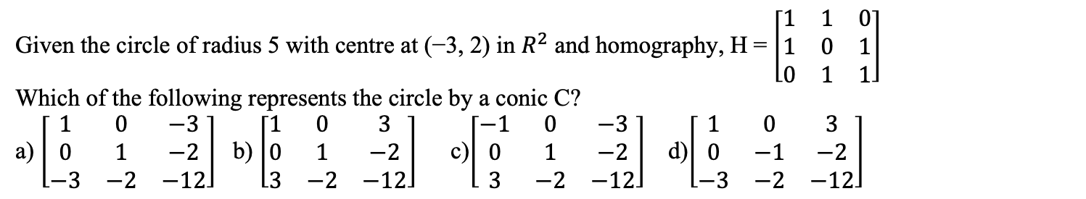
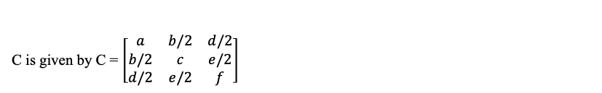
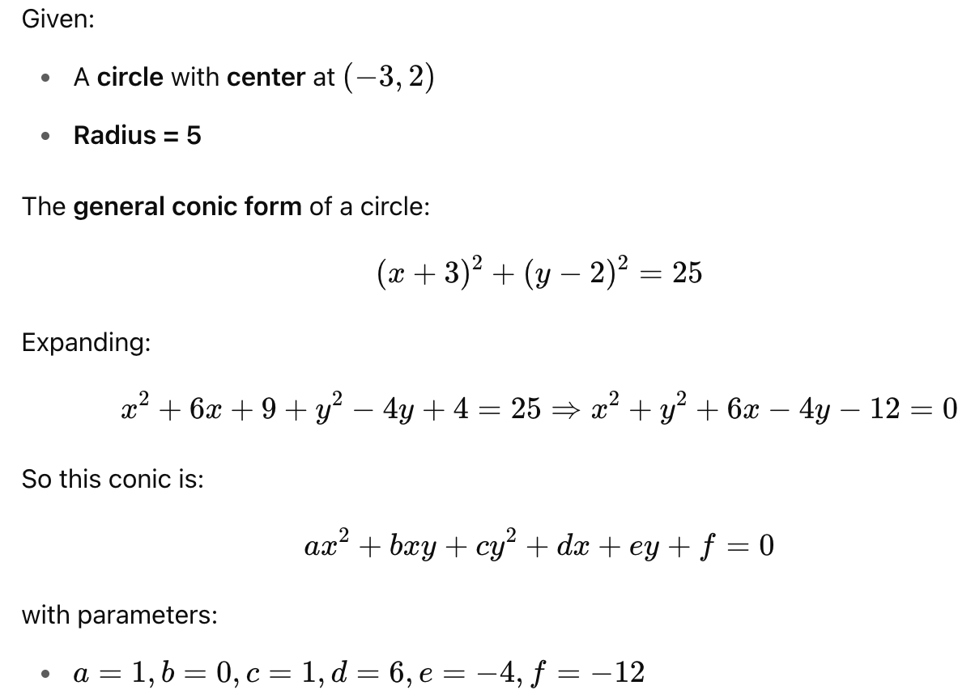
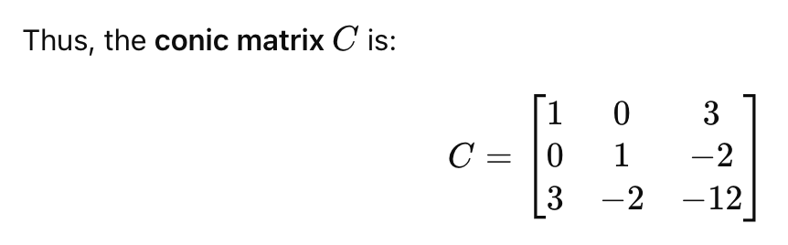
QUESTION 13
SOLUTION 13
CORRECT ANSWER 13
b)

Slide 28
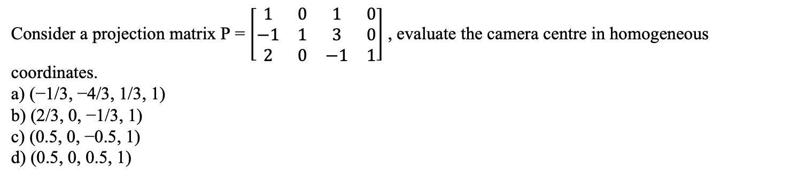
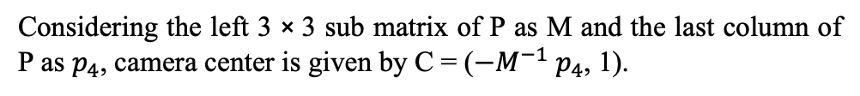
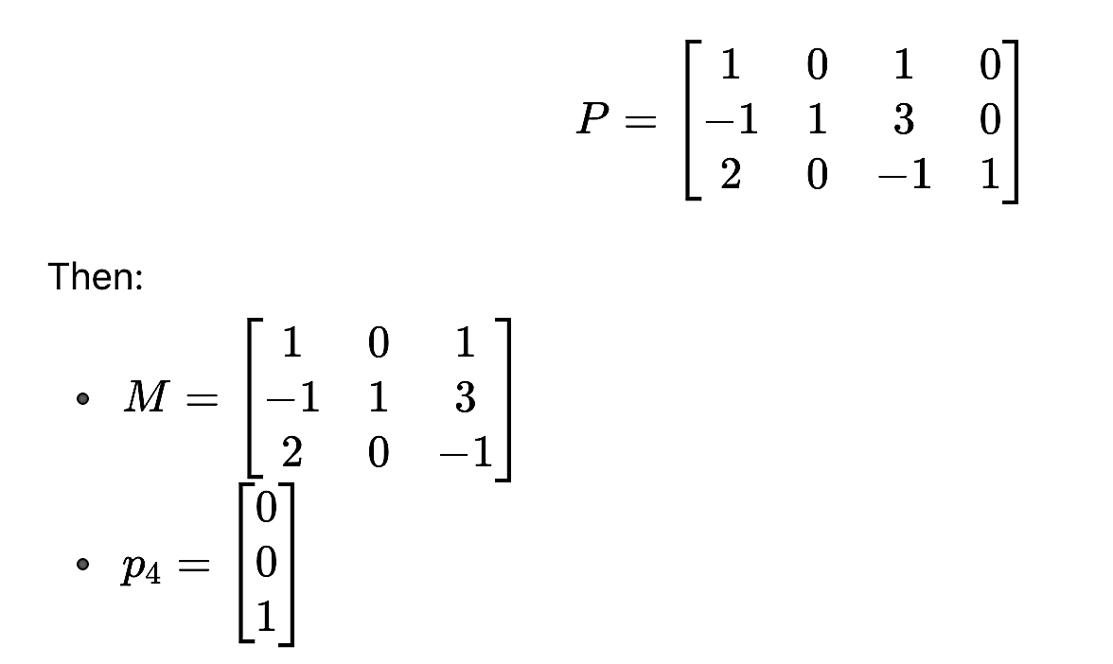
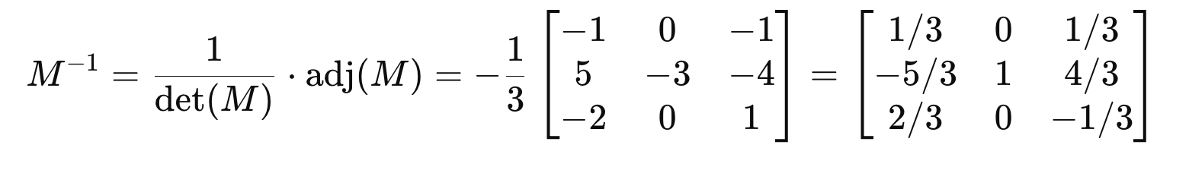
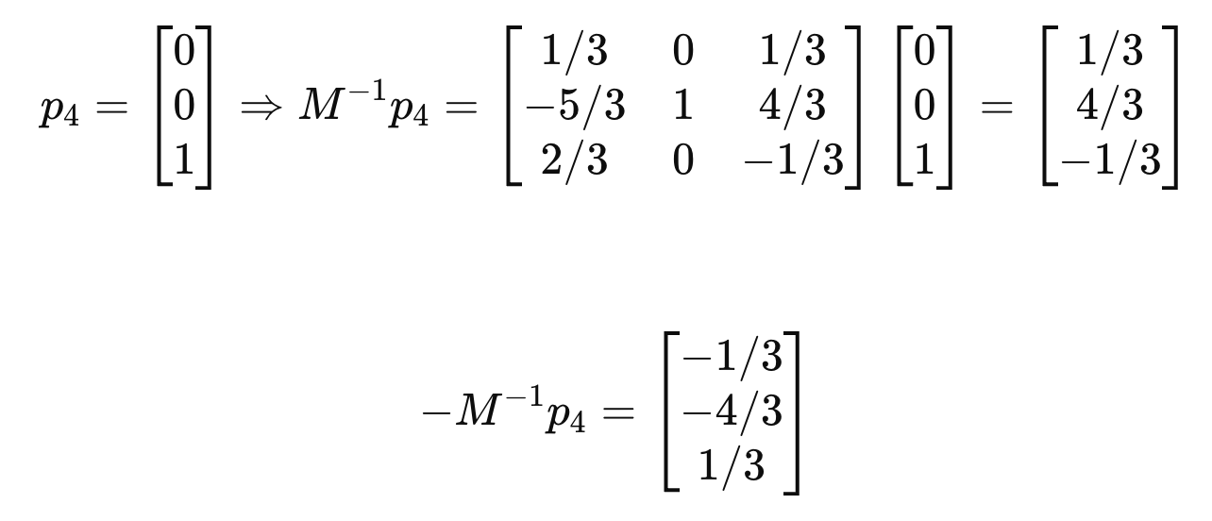
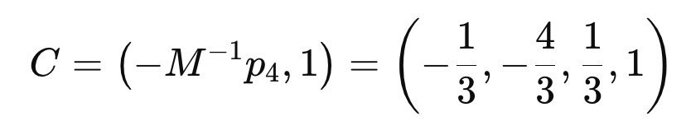
QUESTION 14
SOLUTION 14
CORRECT ANSWER 14
a)

Slide 29
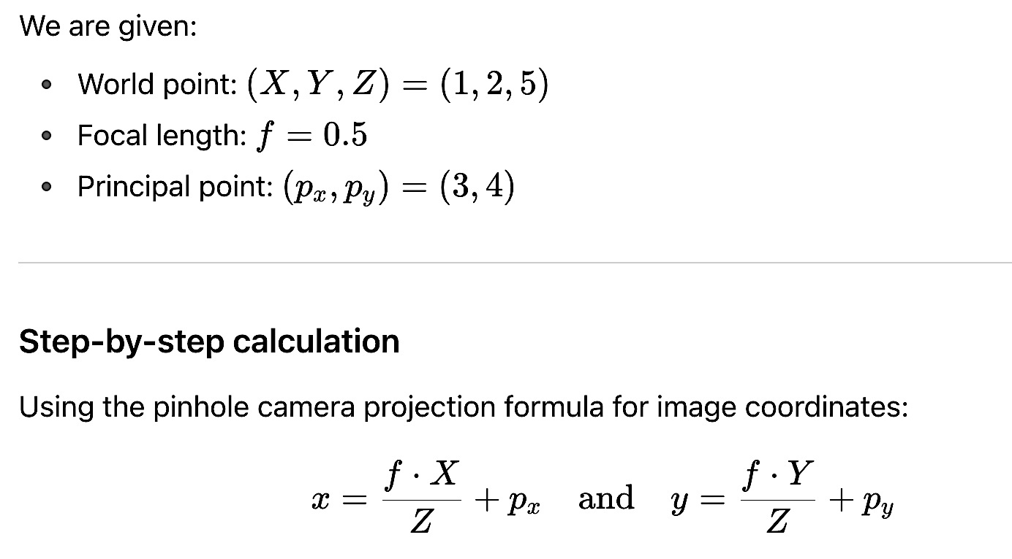

QUESTION 15
If the principal point is located at (3, 4) in the coordinate system of the image plane, what would be the image coordinates of the world point (1, 2, 5), using a pin hole camera with focal length f = 0.5?
a) (2.3, 4.4)
b) (3.3, 3.4)
c) (3.1, 4.2)
d) (2.3, 3.4)
SOLUTION 15
CORRECT ANSWER 15
c)

Slide 30




QUESTION 16
SOLUTION 16
CORRECT ANSWER 16
b)

Slide 31

Based on the given parameters, solve the following question 17, 18 and 19.

Slide 32



QUESTION 17
SOLUTION 17
CORRECT ANSWER 17
b)

Slide 33

QUESTION 18
Given translation vector t as (1, 0, 1), compute the right epipole.
a) (4, 2, 2)
b) (2, 2, 2)
c) (4, 3, 2)
d) (4, 2, 1)
SOLUTION 18
CORRECT ANSWER 18
a)

Slide 34



QUESTION 19
SOLUTION 5
CORRECT ANSWER 19
d)

Slide 35




QUESTION 20
SOLUTION 20
CORRECT ANSWER 20
1

Slide 36





QUESTION 21
SOLUTION 21
CORRECT ANSWER 21
c)

Slide 37


QUESTION 22
SOLUTION 22
CORRECT ANSWER 22
a)

Slide 38




QUESTION 23
SOLUTION 23
CORRECT ANSWER 23
b)

Slide 39


QUESTION 24
SOLUTION 24
CORRECT ANSWER 24
4.20

Slide 40


QUESTION 25
SOLUTION 25
CORRECT ANSWER 10
c)

Slide 41



QUESTION 26
Given two features each of size 4 as f = [4, 1, 2, 4] and g = [9, 1, 2, 2]. Compute normalized cross correlation and cosine similarity, respectively.
a) 7 and 5.38
b) 0.632 and 0.849
c) 2 and 4.38
d) 8 and 4.38
SOLUTION 26
CORRECT ANSWER 26
b)

Slide 42


QUESTION 27
Find KL distance between A and B with probability distribution (0.2, 0.4, 0.15, 0.1, 0.05) and (0.3, 0.35, 0.05, 0.2, 0.15) respectively.
a) 0.0129
b) −0.158
c) −0.084
d) None of the above
SOLUTION 27
CORRECT ANSWER 27
a)

Slide 43




QUESTION 28
Using the method of least squares, find an equation of the form y = ax + b that fits the data given as (x, y) coordinates. [(0, 1), (1, 5), (2, 10), (3, 11), (4, 13)]
a) y = 8x − 8
b) y = 3x + 12
c) y = 3x + 2
d) y = 3x − 2
SOLUTION 28
CORRECT ANSWER 28
c)

Slide 44

29 and 30

Slide 45


QUESTION 29
SOLUTION 29
CORRECT ANSWER 29
a)

Slide 46




QUESTION 30
SOLUTION 30
CORRECT ANSWER 30
b)

Slide 47

Based on the given information, solve questions 31 and 32.

Slide 48


QUESTION 31
SOLUTION 31
CORRECT ANSWER 31
59.5

Slide 49




QUESTION 32
SOLUTION 32
CORRECT ANSWER 32
83

Slide 50




QUESTION 33
Consider the coefficients of first fundamental form are given by E = 5, F = 1, G = 3 and the coefficients of second fundamental form as e = 3, f = 7, g = 3. Compute the Gaussian curvature K.
a) −23/7
b) −20/7
c) −8/8
d) 23/4
SOLUTION 33
CORRECT ANSWER 33
b)

Slide 51



QUESTION 34
SOLUTION 34
CORRECT ANSWER 34
d)

Slide 52


QUESTION 35
Consider the coefficients of first fundamental form are given by E = 2, F = 3, G = 7 and the coefficients of second fundamental form as e = 4, f = 0, g = 3. Compute the mean curvature H. (Answer upto 2 decimal places)
a) 4.25
b) 3.40
c) 3.25
d) 3
SOLUTION 35
CORRECT ANSWER 35
b)

Slide 53



QUESTION 36
Consider the following table. The table shows the points on x-axis and its corresponding class.
We introduce two new points on x-axis, 3.7 and 4.2. Compute KNN (K=3) to determine their class.
a) 3.7 : Class 2 and 4.2: Class 1
b) 3.7 : Class 1 and 4.2: Class 2
c) 3.7 : Class 1 and 4.2: Class 1
d) 3.7 : Class 2 and 4.2: Class 2
SOLUTION 36
CORRECT ANSWER 36
b)

Slide 54

Consider the following neural network. Ix : Inputs; Bx : Biases; Hx : Hidden Layers; Ox : Outputs.
If all the Activation Functions are ReLU, then answer the following question 37 and 38.

Slide 55



QUESTION 37
SOLUTION 37
What will be the output for Input [1, 1]?
a) O1 : 0, O2 : 0
b) O1 : 0, O2 : 1
c) O1 : 1, O2 : 0
d) O1 : 1, O2 : 1
CORRECT ANSWER 37
d)

Slide 56


QUESTION 38
What will be the output if sigmoid activation functions are used in the output layer instead of ReLU? Note: Hidden layer still has ReLU.
a) O1 : 0.731, O2 : 1
b) O1 : 0.731, O2 : 0.731
c) O1 : 0.5, O2 : 0.5
d) O1 : 1, O2 : 0.731
SOLUTION 38
CORRECT ANSWER 38
b)

Slide 57




QUESTION 39
Consider a multilayer feed forward network which takes a 10-D feature vector as input and produces a 2-D output vector. The network has one hidden layer with number of neurons 15. Please note that the input vector is the input to the first hidden layer. What is the dimension of the parametric space over which the optimization process would be carried out to train the network?
SOLUTION 39
CORRECT ANSWER 39
197

Slide 58



QUESTION 40
We want to classify whether a special wire is good or not. Consider the following table consisting of four samples.
We introduce a new wire with durability 3 and strength 7. Which of the following statements are true after computing KNN (K=3)?
a) (3, 7) is a bad wire.
b) The nearest sample to (3, 7) is at a distance of 4.
c) (3, 7) is a good wire.
d) The nearest sample to (3, 7) is at a distance of 3.
SOLUTION 40
CORRECT ANSWER 40
c), d)

Slide 59



QUESTION 41
SOLUTION 41
CORRECT ANSWER 41
a)

Slide 60

QUESTION 42
From the data points given in question 1, what is the total variance in PCA?
a) 4.65
b) 3.336
c) 12.86
d) 1.33
SOLUTION 42
CORRECT ANSWER 42
b)

Slide 61



QUESTION 43
SOLUTION 43
CORRECT ANSWER 43
a)

Slide 62



QUESTION 44
SOLUTION 44
CORRECT ANSWER 44
a)

Slide 63

QUESTION 45
Up-convolve the following input x using the filter h. What is the value at (2, 2) in the up-convolved feature map? We assume index of first cell of any 2D-matrix is (0,0).
Given: x(0, 0) = 1, x(0, 1) = 2, x(1, 0) = 3, x(1, 1) = 1.
h(0, 0) = 0, h(0, 1) = 1, h(0, 2) = 0, h(1, 0) = 2, h(1, 1) = 2, h(1, 2) = 1, h(2, 0) = 0, h(2, 1) =1, h(2, 2) = 0.
SOLUTION 45

Slide 64




Slide 65


QUESTION 46
The softmax predictions of four different classes are [0.1 0.3 0.2 0.4]. Calculate the cross entropy loss for this sample (use natural logarithm) if the true labels are [0 0 0 1]. Round off the answer to 4 places of decimals.
SOLUTION 46
CORRECT ANSWER 46
0.9163

Slide 66
Consider an input image of dimension 19 × 15 × 3. It passes through a convolutional layer with 64 kernels of dimension 5 × 5 × 3. The image has been zero padded on both sides with 1 × 1 padding and convolved using 2 × 2 stride.
Based on the given data solve the following questions 47, 48 and 49.

Slide 67


QUESTION 47
What is the dimension of the activation map?
a) 15 × 11 × 64
b) 15 × 11 × 3
c) 9 × 7 × 64
d) 9 × 7 × 3
SOLUTION 47
CORRECT ANSWER 47
c)

Slide 68


QUESTION 48
Calculate the number of parameters in the convolutional layer.
SOLUTION 48
CORRECT ANSWER 48
4864

Slide 69

QUESTION 49
Assume that the convolutional layer is followed by a MaxPool layer with kernel size 2 × 2.
Calculate the number of parameters in the pooling layer.
SOLUTION 49
CORRECT ANSWER 49
0

Slide 70

QUESTION 50
In an object detection problem, the time taken to generate all proposals is 0.75. There are 4 number of proposals generated. What is the inference time of a Faster RCNN if the convolution time and the time taken by the fully connected layer are 2.25 and 1.75, respectively? Round off the answer to 2 places of decimals.
SOLUTION 50
CORRECT ANSWER 50
9.25

Slide 71


Contact me: https://sites.google.com/view/ayans-agribot/home

